Slide 1
“THE PERCEPTION PROCESS”
Communication and Presentation Skills
Department of Computer Science
FAST NU Peshawar
Lecture by Ms. Maryam Ali Khan

Slide 2
A young couple, Lisa and John, moved into a new neighborhood. One morning while they were eating breakfast, Lisa looked out the window and watched her next-door neighbor hanging out her washed clothes.
“That laundry’s not clean!” Lisa exclaimed. “Our neighbor doesn’t know how to get clothes clean!”
John looked on but remained silent.
Every time her neighbor would hang her wash to dry, Lisa would make the same comments.
A few weeks later Lisa was surprised to glance out her window and see a nice, clean wash hanging in her neighbor’s yard. She said to her husband, “Look, John﻿—she’s finally learned how to wash correctly! I wonder how she did it.”
John replied, “Well, I have the answer for you. You’ll be interested to know that I got up early this morning and washed our windows!”

Slide 3
IS PERCEPTION THE SAME AS REALITY?

Slide 4
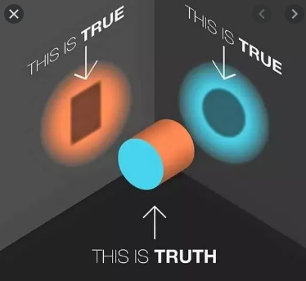

Slide 5
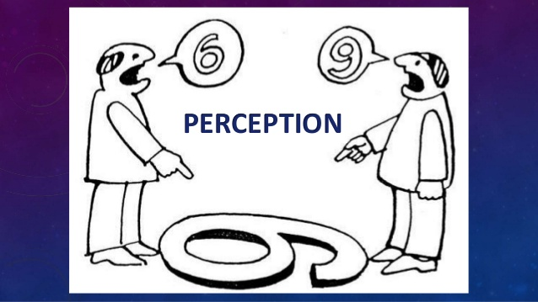

Slide 6
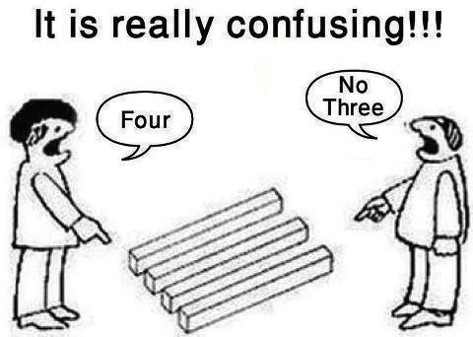

Slide 7
Ever said
“LOOK AT IT FROM MY PERSPECTIVE”?

Slide 8
WHAT IS PERCEPTION?
The lens through which we see reality
The process of gathering sensory information and assigning meaning to it

Slide 9
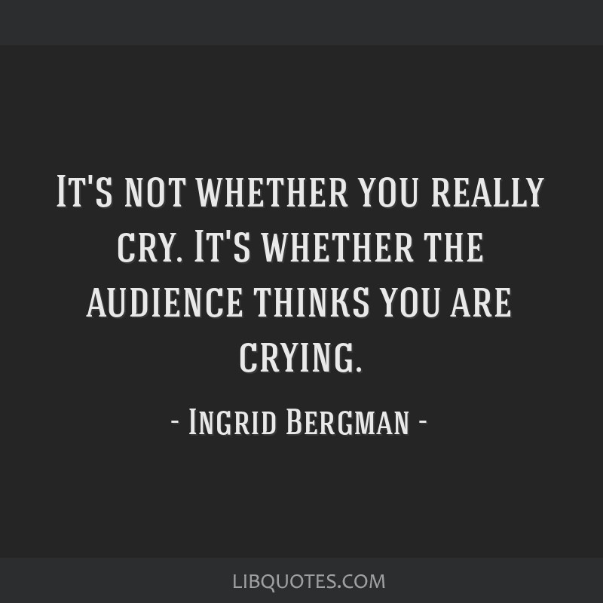

Slide 10
THE PERCEPTION PROCESS
The process of selectively attending and assigning meaning to information
At times, our perception of the world, other people, and ourselves agree with the perception of others. At other times, it does not agree.

Slide 11
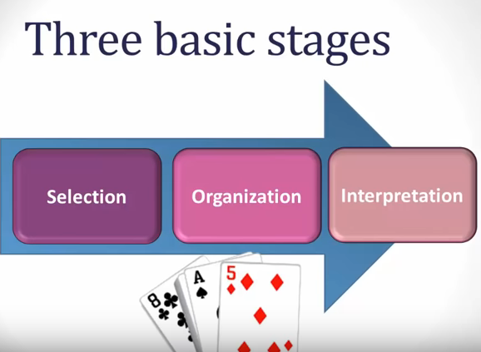

Slide 12
PERCEPTION IS BASED ON:
Selection
  Needs
  Interests
  Expectations
Organization
  Simplicity
  Pattern
Interpretation
Dual Processing

Slide 13
1. SELECTION
Exposed to stream of sensory stimuli
Attention focused on little of it
Out of so many channels, only a few are considered based on our needs, interests and expectations
We cant focus on everything
We pay attention to certain things while others go unnoticed
Attention acts like a spotlight

Slide 14
Imagine that you are at a party for a friend hosted at a bustling restaurant. Multiple conversations, the clinking of plates and forks, and many other sounds compete for your attention. Out of all these noises, you find yourself able to tune out the irrelevant sounds and focus on the amusing story that your dinner partner shares.

Slide 15
A college professors perception of an appropriate work attire is slightly different from the perception of an appropriate work attire of a banker

Slide 16
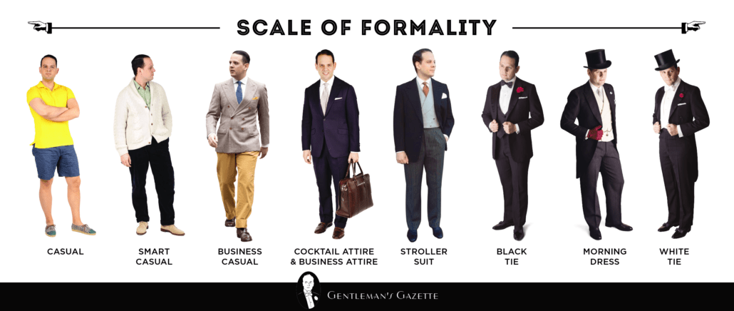

Slide 17
A. NEEDS
Paying attention according to our biological and psychological needs
A poor man thinks about food and shelter
A rich man thinks about luxuries of life
A tired man thinks about finding a place to sleep

Slide 18
B. INTERESTS
Paying attention according to our interest
Imagine that you are at a party for a friend hosted at a bustling restaurant. Multiple conversations, the clinking of plates and forks, and many other sounds compete for your attention. Out of all these noises, you find yourself able to tune out the irrelevant sounds and focus on the amusing story that your dinner partner shares.

Slide 19
C. EXPECTATIONS
Play a strong role in determining the way we see the world
We are likely to see what we expect and miss what violates our expectations
People who are warned that they are about to taste something bad rate what they do taste more negatively than people who are told that the taste won’t be so bad

Slide 20
2. ORGANIZATION
Through the process of attention and selection we reduce the number of stimuli
Our brain organizes these stimuli using the principles of simplicity and pattern

Slide 21
A. SIMPLICITY
The brain simplifies a complex stimuli
Based on what someone is wearing, how she is standing, the expression on her face, we may perceive that person as a business executive, a doctor or a house wife

Slide 22
B. PATTERN
Our brain organizes the stimuli into patterns for better understanding
A crowd of people may be perceived as:
  Gender: men and women
  Age: Young or old

Slide 23

6 LINES OR 3 SETS OF LINES?

Slide 24
3. INTERPRETATION
The brain not only selects and organizes information but also assigns meaning to it. Look at the following:
  A. 0333 123457
  B. 19 0089
  C. 4632 7365 2596 2174
If you are used to seeing similar sets then you will interpret A as a telephone number, B as a roll number and C as a credit card number.

Slide 25
4. DUAL PROCESSING
Automatic Processing
Conscious Processing

Slide 26
A. AUTOMATIC PROCESSING
Do you ever tell yourself, “Hey, I don’t go through all of these steps. I just automatically understand what is going on.”
If yes, then this is automatic processing
Automatic processing uses heuristics(short-cut rules of thumb for understanding how to perceive something based on past experience.

Slide 27
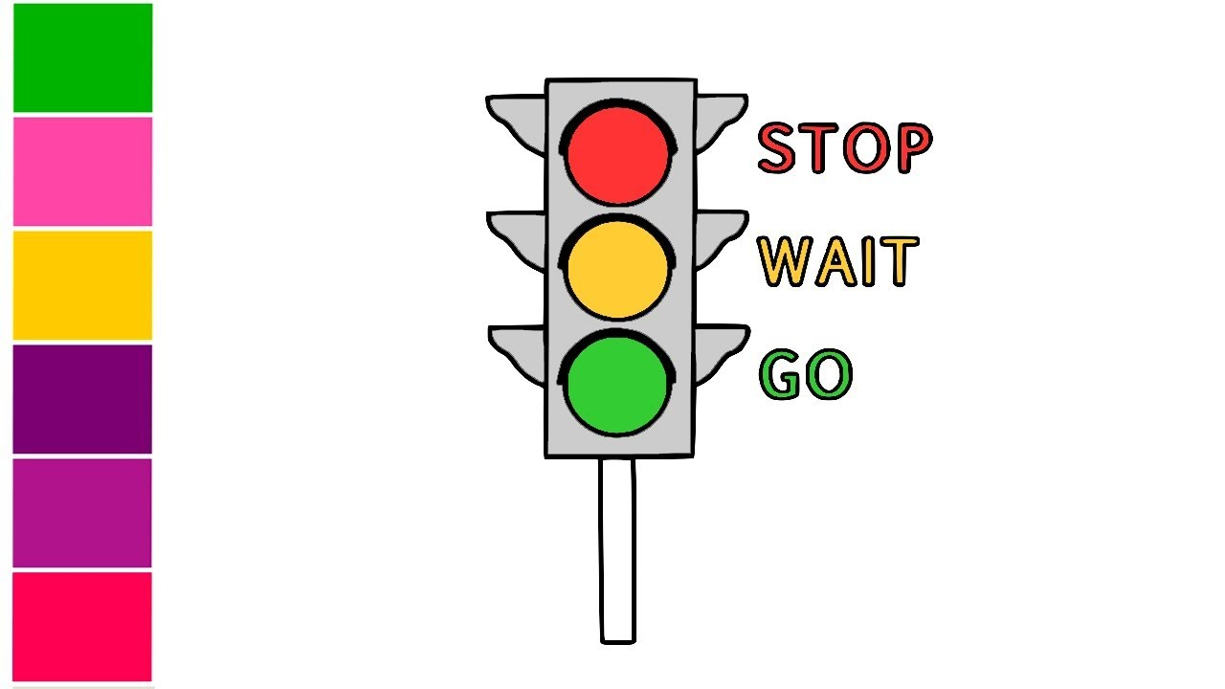
Why do we stop at the red light signal?
What about the green light?
  You unconsciously take your foot off the brake at the green signal

Slide 28
B. CONSCIOUS PROCESSING
Encountering things that are out of our past experience
How do we perceive something we have not done before?
Remember when you were first learning to drive?

Slide 29
PERCEPTIONS OF SELF: SELF-CONCEPT
AND SELF-ESTEEM
Self-concept is your self-identity
Self-esteem is your overall evaluation of your competence and personal worthiness

Slide 30
FORMING AND MAINTAINING A SELF-CONCEPT
Our self-concept is essentially our identity, that is, who we think we really are. We develop our self-concept based on our experiences and others’ reactions and responses to us.
Personal experiences
Reactions and responses of others

Slide 31
THE INFLUENCE OF GENDER AND CULTURE ON SELF-PERCEPTIONS
A person’s culture has a strong influence on the self-perception process. In individualistic cultures, such as the United States, people stress the self and personal achievement. In individualistic cultures, people care about self-concept, self-esteem, and self-image.

Slide 32
CHANGING SELF-PERCEPTIONS
Self-concept and self-esteem are enduring characteristics, but they can be changed. At times, comments that contradict your current self-perception lead you to slowly change it.

Slide 33
ACCURACY AND DISTORTION OF SELF-PERCEPTIONS
The accuracy of our self-concept and self-esteem depends on the accuracy of our own perceptions and how we process others’ perceptions of us. All of us experience success and failure, and all of us hear praise and criticism.
Incongruence
the gap between our inaccurate self-perceptions and reality, is a problem because our perceptions of self are more likely than our true abilities to affect our behavior
self-fulfilling prophecy
a false perception of a situation or characteristic or skill that leads to behaviors that perpetuate that false perception as true.

Slide 34
ACCURACY AND DISTORTION OF SELF-PERCEPTIONS
Filtering messages
A second way that our self-perceptions can become distorted is through the way we filter what others say to us. We are prone to pay attention to messages that reinforce our current self-image, whereas messages that contradict this image may not “register” or may be downplayed.

Slide 35
THE EFFECTS OF SELF-PERCEPTIONS ON COMMUNICATION
Just as our self-concept and self-esteem affect how accurately we perceive ourselves, so too do they influence our communication by moderating competing internal messages in our self-talk, influencing how we communicate about ourselves with others, and affecting communication apprehension.
Self-perceptions moderate how we talk to ourselves.
Self-perceptions influence how we talk about ourselves with others.
Self-perceptions affect communication apprehension.

Slide 36
PRESENTING SELF TO OTHERS
Your self-concept and self-esteem are the “true” perceptions of what you think of yourself. But when we interact with others, most of us mask some of who we really think we are so that we can meet or violate others expectations.
Self-Monitoring is the internal process of observing, analyzing, and regulating your own behavior based on your analysis of the situation and others’ responses to you.
Social Construction of Self: we present different personas in response to different situations and relationships, and we change ourselves in the process. We socially construct ourselves through the roles we enact. A role is a pattern of learned behaviors that we use to meet the perceived demands of a particular context.

Slide 37
PERCEPTION OF OTHERS
As we encounter new people, or as we experience new situations in our ongoing relationships, most of us feel somewhat to profoundly anxious. This process of monitoring the social environment to learn more about self and others is called uncertainty reduction (Littlejohn & Foss, 2007). As people interact, they gain information and form impressions of others.
Observing Others - Our initial social perceptions or first impressions of others are usually made from our observations of how they look and act. We often judge people to be friendly, intelligent, or “cool” based on how physically attractive we fi nd them (Aronson, 1999, p. 380).

Slide 38
OBSERVING OTHERS
implicit personality theories – assumptions about which physical characteristics and personality traits or behaviors are associated with one another.
  halo effect to generalize and perceive that a person has a whole set of characteristics when you have actually observed only one characteristic, trait, or behavior.

Slide 39
USING STEREOTYPES
A stereotype is “a generalization, usually exaggerated or oversimplified and often offensive, used to describe or distinguish a group”
  Prejudice a rigid attitude that is based on group membership and predisposes an individual to feel, think, or act in a negative way toward another person or group.
  Discrimination a negative action toward a social group or its members on account of group membership.

Slide 40
EMOTIONAL STATE
A final factor that affects how accurately we perceive others is our emotional state at the time of the interaction (Forgas, 1991).
Our emotional state also affects our attributions (Forgas, 2000). Attributions are reasons we give for others’ behavior (Heider, 1958). According to attribution theory, what we determine—rightly or wrongly—to be the causes of others’ behavior has a direct impact on our perceptions of them.

Slide 41
PERCEIVING OTHERS’ MESSAGES
Our observations of others and our emotional state certainly affect how we perceive others. Not only that, they also tend to influence how we perceive the messages others send to us. Two additional factors that influence how we perceive others’ messages are
Context
shared language

Slide 42
IMPROVING THE ACCURACY OF SOCIAL PERCEPTIONS
The following guidelines can aid you in constructing accurate impressions of others and in assessing your perceptions of others’ messages.
Question the accuracy of your perceptions.
Seek more information to verify perceptions.
Realize that your perceptions of a person will change over time.
Use the skill of perception checking.

Slide 43
